Slide 1
A ONE STOP TRAVEL SHOP

Slide 2
FAIR MOUNT
HOLIDAYS & TRAVEL
Fair Mount Holidays (FM Holidays) established in 2006 and is head quartered in Sharjah-UAE, Corporate office in Dubai and having branches in UAE & India.

Slide 3
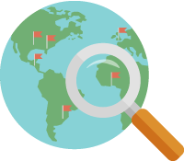
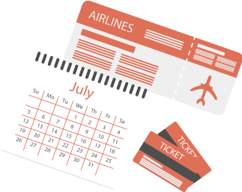
OUR SERVICES
TRAVEL PLANNING
TRAVEL GUIDANCE
TRAVEL ASSISTANCE
TRAVEL CHOICES

Slide 4
ADVANTAGES
PROFESSIONAL, HIGHLY QUALIFIED AND FRIENDLY STAFF. IMPARTIAL, ACCURATE AND RELIABLE TRAVEL ADVICE.
DEDICATED CONSULTANTS HANDLING INDIVIDUAL CORPORATE ACCOUNTS.
EXCLUSIVE NEGOTIATED AND CORPORATE FARES AND RATES. CREATIVE FARE ANALYSIS.
GUARANTEED RESPONSE TIMES. 24-HOUR EMERGENCY ASSISTANCE FROM PROFESSIONAL TRAVEL CONSULTANTS
FLEXIBILITY AND THE ABILITY TO RESERVE AND CHANGE FLIGHTS WITHOUT COMMITMENT UNTIL PLANS ARE CONFIRMED.

Slide 5
FM CORPORATES SERVICES
MULTIPLE OPTION ON EVERY BOOKING
DEDICATED PERSONNEL FOR CORPORATE HOUSES
QUALITY CHECK PROCESSES & SERVICE LEVEL AGREEMENTS
DELIVERY OF DOCUMENTS AT YOUR DOOR STEPS
GLOBAL CONTRACTS & CUSTOMIZED SERVICES
ADVANCE INFORMATION TECHNOLOGY

Slide 6
FM SPECIALS
MICE OFFERS
IN BOUND TOURS (UAE & INDIA)
CRUISES & HOUSE BOATS
MEDICAL TOURISM & AYURVEDA
GROUP HOLIDAYS
HONEY MOON PACKAGES
PILGRIMAGE PACKAGES
EDUCATIONAL TOUR SERVICES

Slide 7
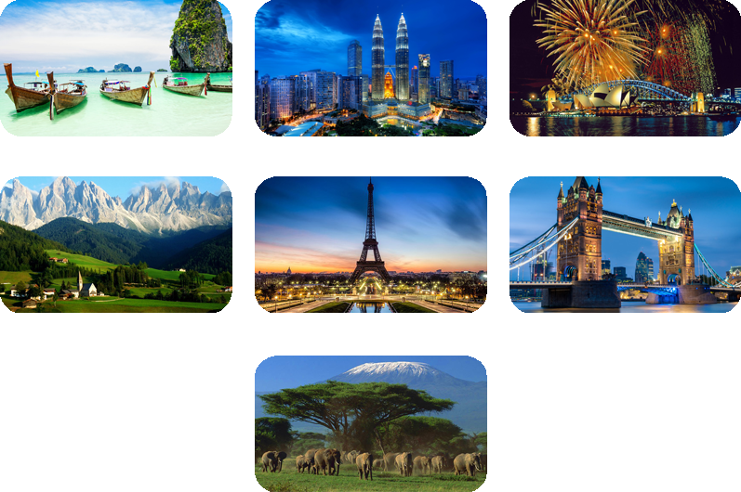
HOLIDAYS
THAILAND
MALAYSIA
AUSTRALIA
AUSTRIA
PARIS
LONDON
KENYA

Slide 8
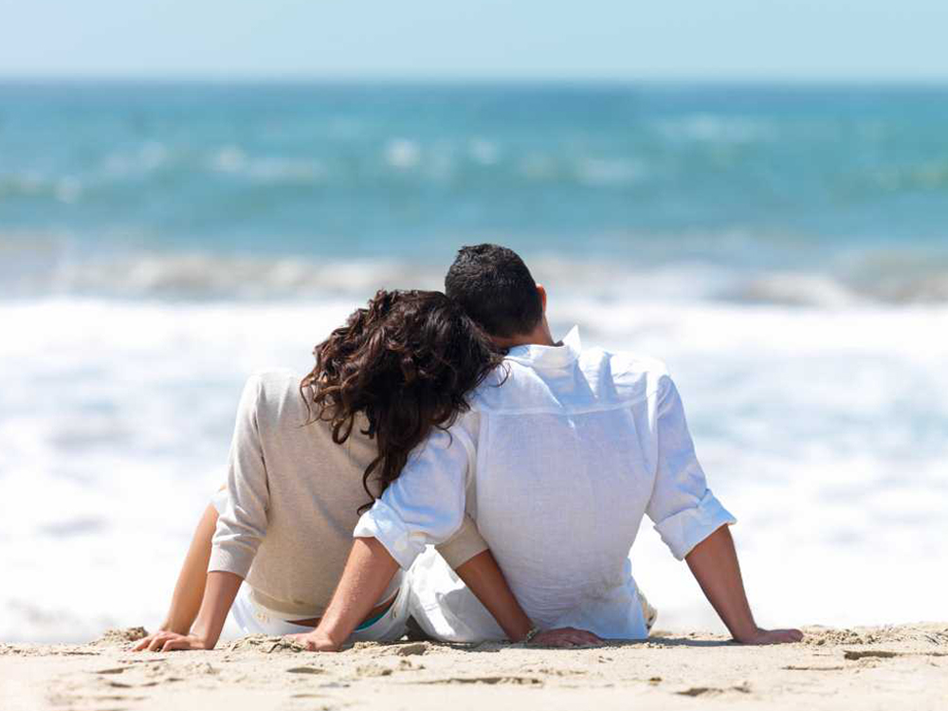
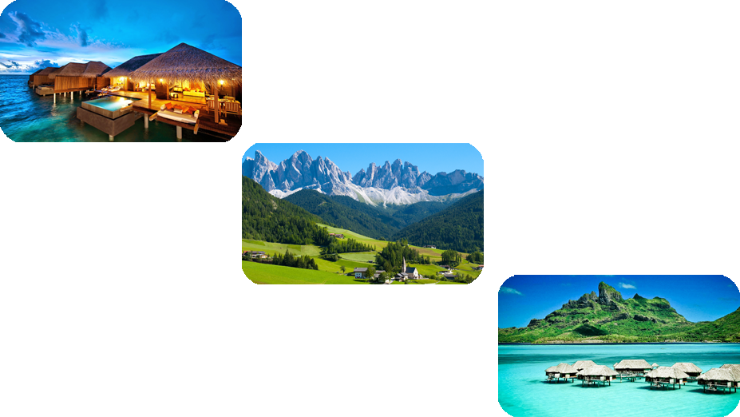
HONEYMOON
MALDIVES
SWISS
MAURITIUS

Slide 9
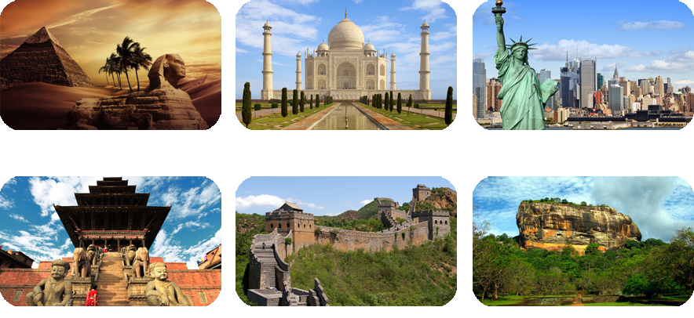
EDUCATIONAL TOUR
EGYPT
INDIA
USA / ORLANDO SPACE CAMP
NEPAL
CHINA
SRI LANKA

Slide 10
CONTACT US
FOR:
Airline Reservations & Global Ticketing
Outbound & Inbound Holiday Packages
Worldwide Hotels & Resorts Booking
Furnished Apartments Reservation
Readymade & Tailor Made Packages
Pilgrimage Tours
Educational Tours
Honeymoon Packages
Group & MICE Packages
Passport & Visa Assistance
Meet and Greet, Car Hire and Airport Transfer
Worldwide Rail / Bus Reservations
Desert Safari & Dhow Cruise in Dubai
Visa Change, City Tour and Many More
Worldwide Travel Insurance

Slide 11
CERTIFIED:

Slide 12
AWARDED:
SHARJAH TOURISM EXCELLENCE AWARD 2012
Best Tour Operator 2012 is ‘FM Holidays & Travel’

Slide 13
APPOINTED:
GSA - KERALA TOURISM DEVELOPMENT CORPORATION

Slide 14
CONTACT US:
Call 24/7 : 052 906 7276 e-mail: info@fmholidays.com
Head Office:
P.O. Box 151070, Sharjah, United Arab Emirates
Tel: +971 6 538 5758, Fax: + 971 6 538 4583
Corporate Office
Regional Office
DUBAI:
Oud Mehta Building, Near Wafi Mall,
Tel: +971 4 3960 660 Fax: +971 4 3960 661
KOCHI
1st Floor, Mattammal Building, Ravipuram, M.G. Road. Tel: +91 484 2352 188 / 2354 188
Branches
SHARJAH - Al Shaab Village:
Al Shaab Mall: Al Hazannah, Tel: +971 6 561 7688
PATHANAMTHITTA
P.O Road, Tel: +91 468 2220 188/189/190
SHARJAH - MADAM:
Khasooni Bldg, Tel: +971 6 886 0002
CHENGANNUR
Engg College Jn: M.C Road,Tel: +91 479 2450 188
TRIVANDRUM
1st Floor, Beena Complex, M.C Road , Nalanchira Tel: +91 471 2542 188 / 2545 188
www.fmholidays.com | facebook/fairmountholidays

Slide 15
Thank You

